Slide 1

Morris Park (5) - 3/2024

Slide 2
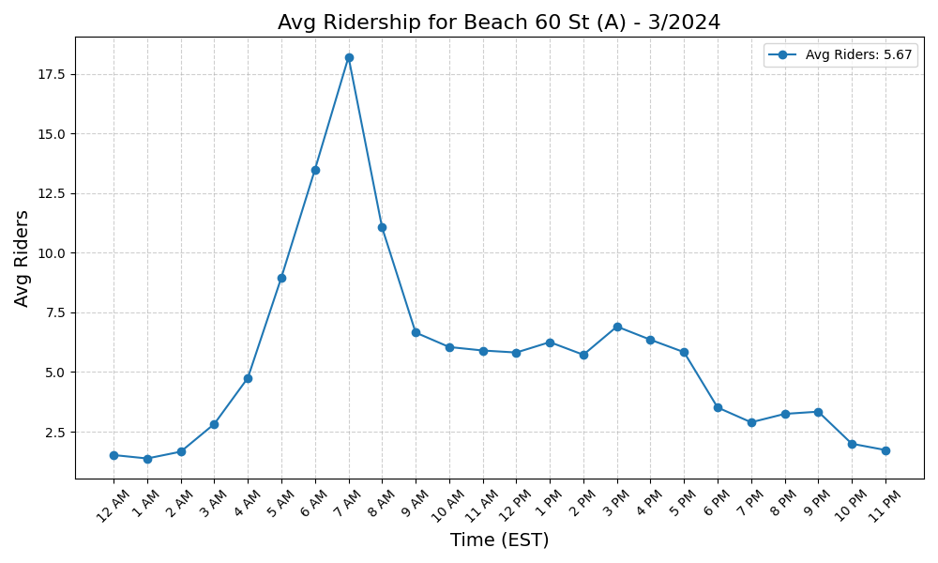
Beach 60 St (A) - 3/2024

Slide 3
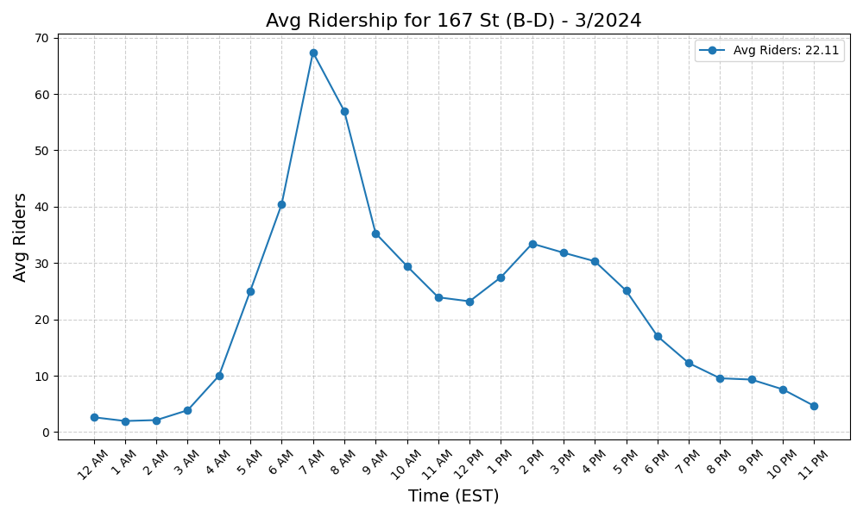
167 St (B-D) - 3/2024

Slide 4
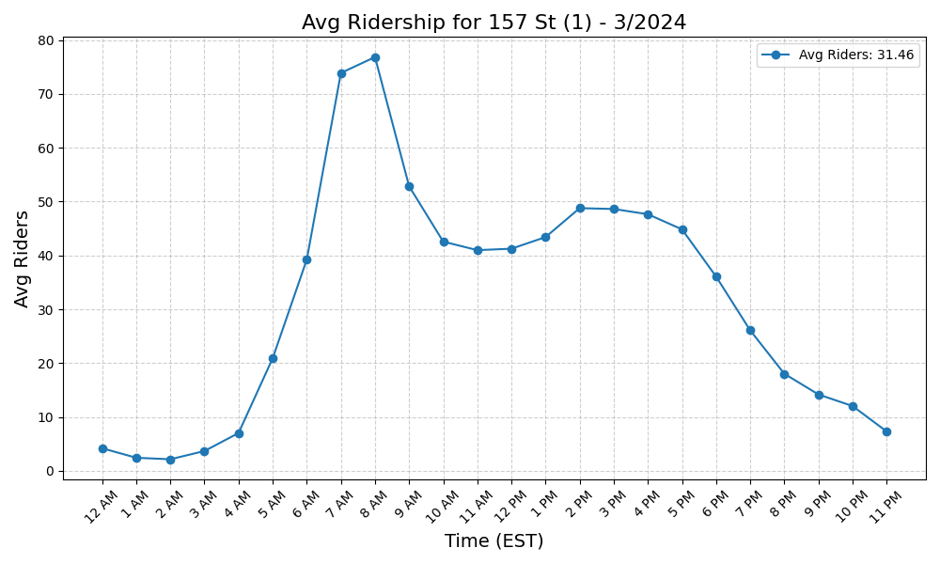
157 St (1) - 3/2024

Slide 5
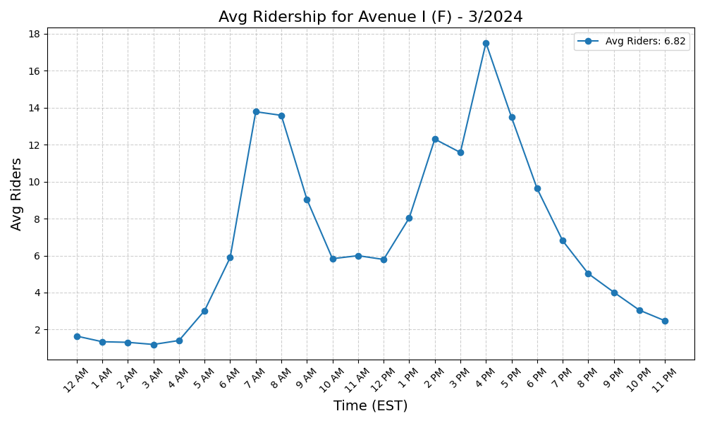
Avenue I (F) - 3/2024

Slide 6
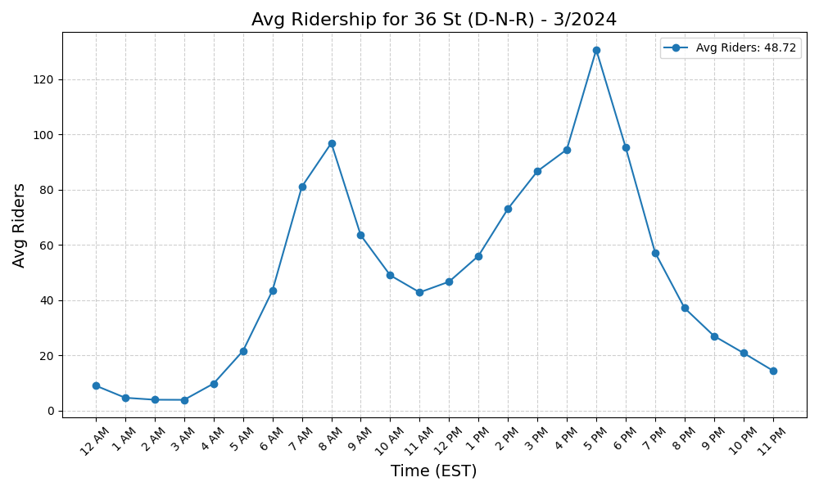
36 St (D-N-R) - 3/2024

Slide 7
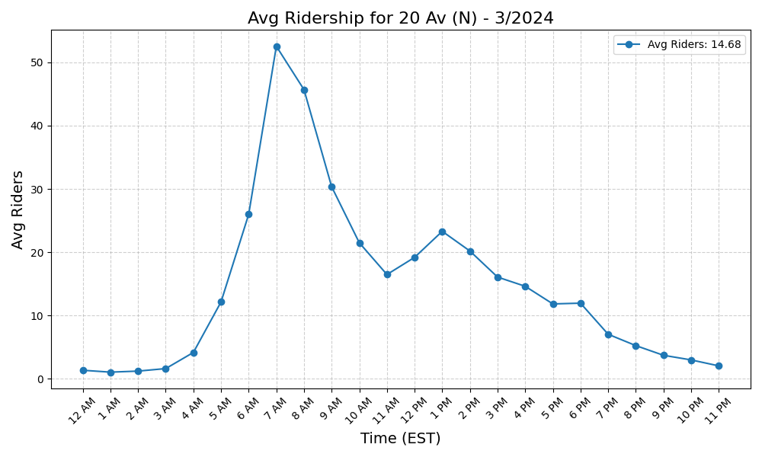
20 Av (N) - 3/2024

Slide 8
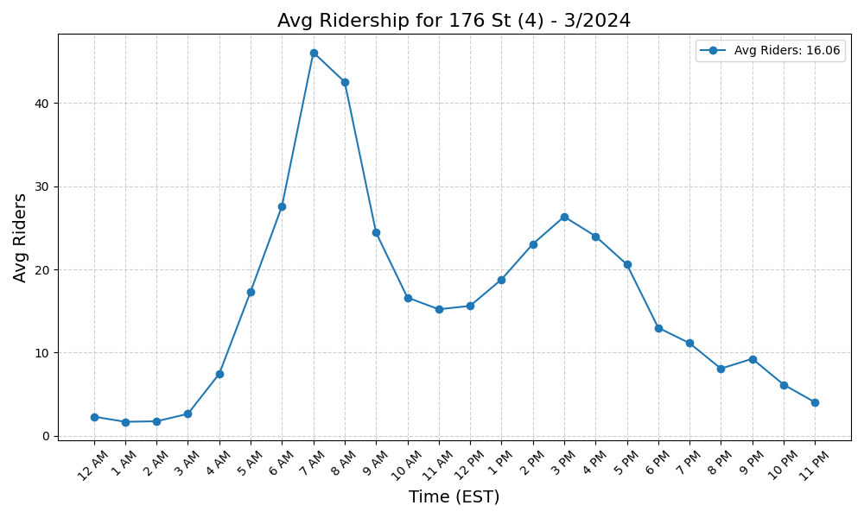
176 St (4) - 3/2024

Slide 9
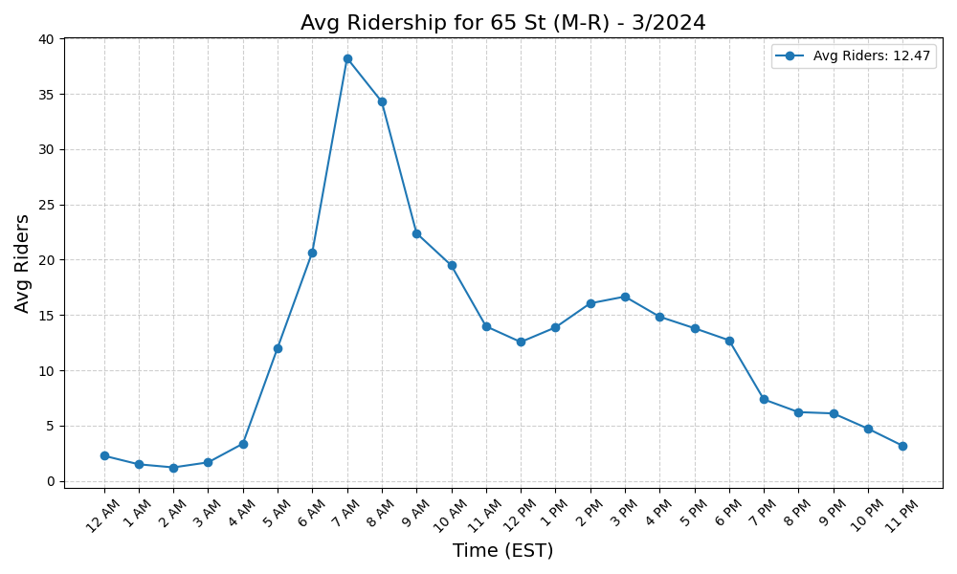
65 St (M-R) - 3/2024

Slide 10
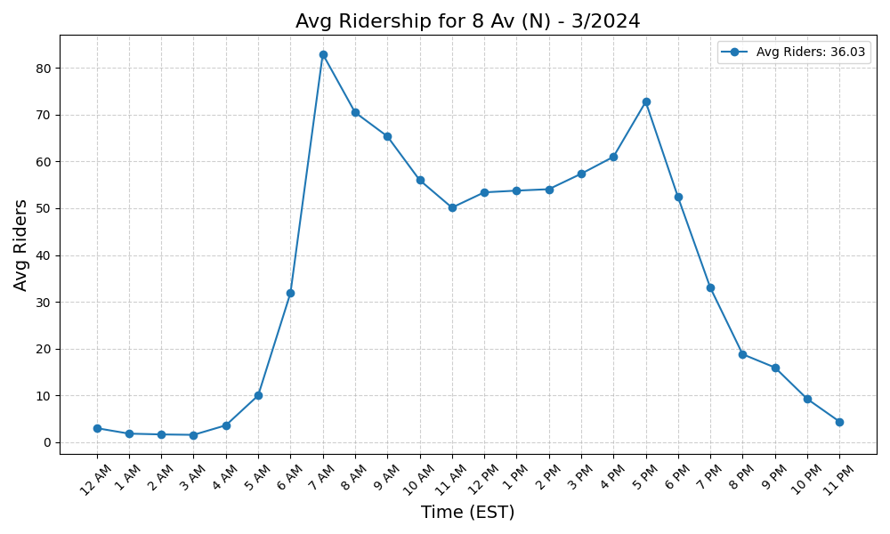
8 Av (N) - 3/2024

Slide 11
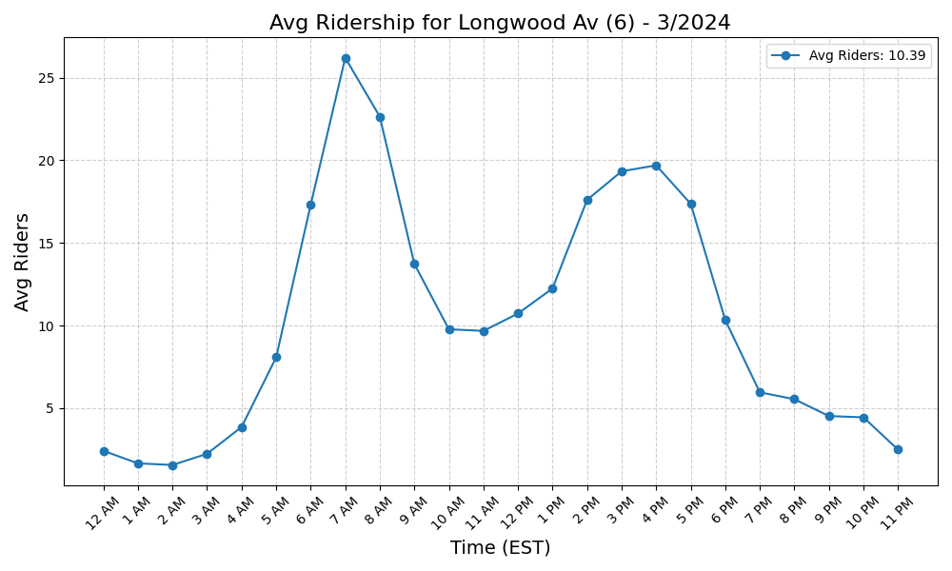
Longwood Av (6) - 3/2024

Slide 12

Avenue U (N) - 3/2024

Slide 13
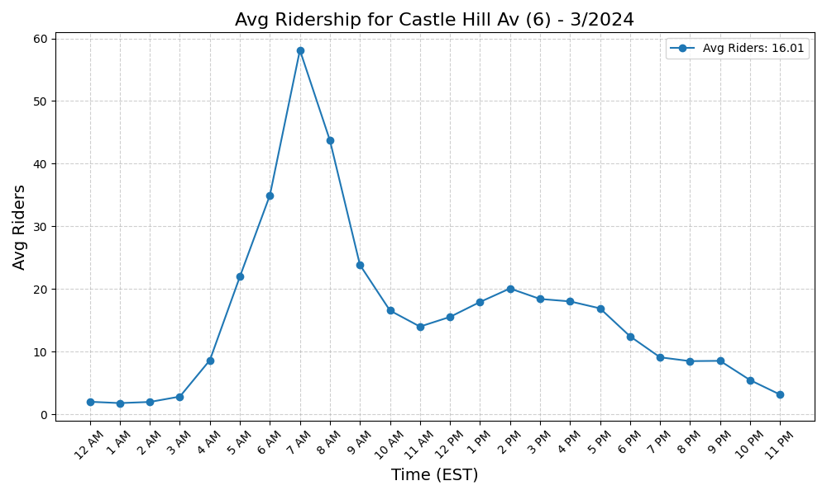
Castle Hill Av (6) - 3/2024

Slide 14
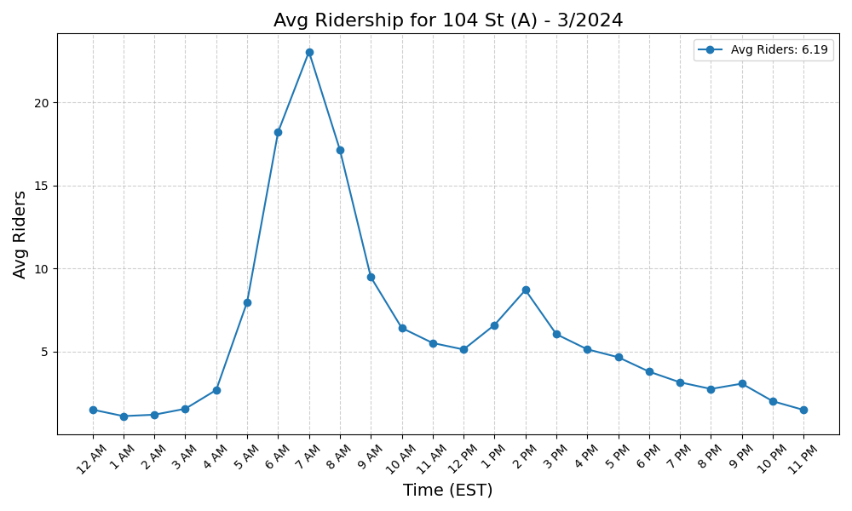
104 St (A) - 3/2024

Slide 15
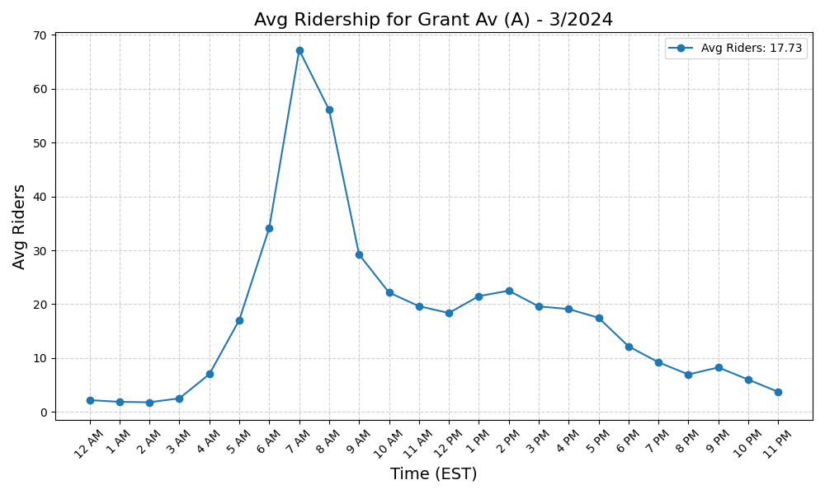
Grant Av (A) - 3/2024

Slide 16
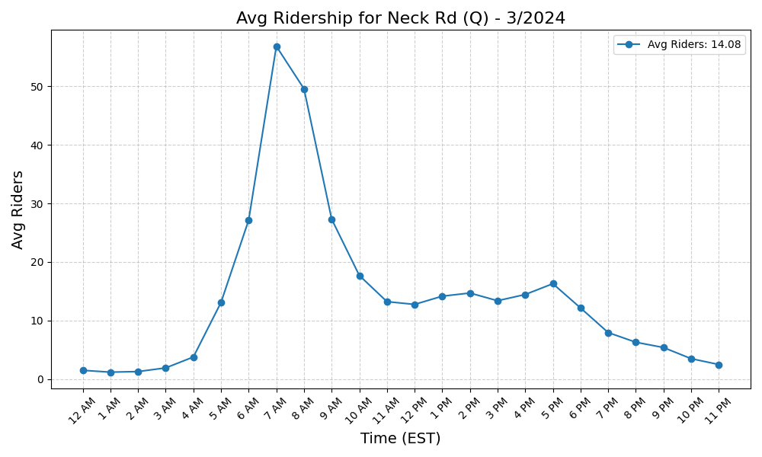
Neck Rd (Q) - 3/2024

Slide 17
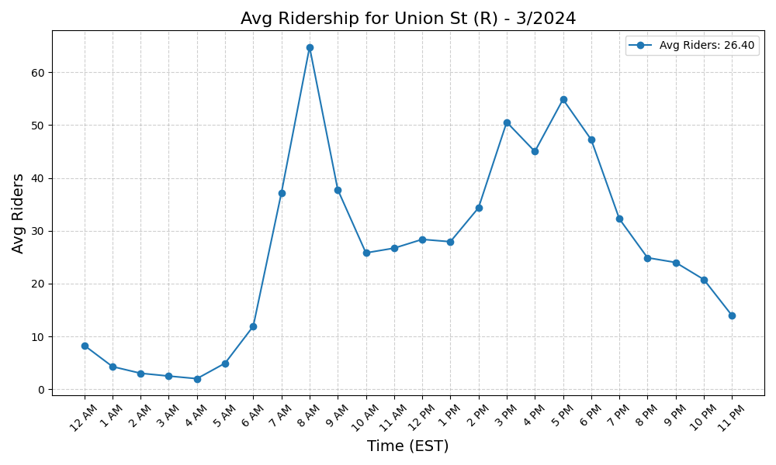
Union St (R) - 3/2024

Slide 18
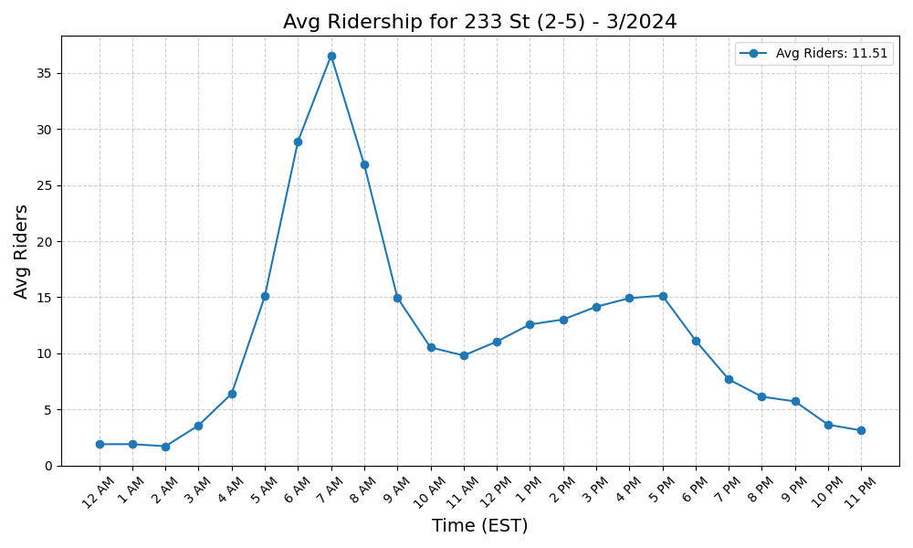
233 St (2-5) - 3/2024

Slide 19
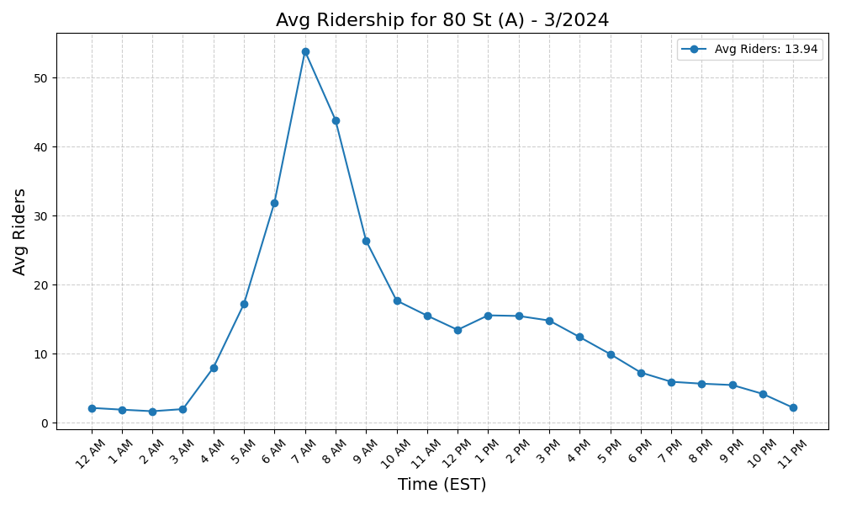
80 St (A) - 3/2024

Slide 20
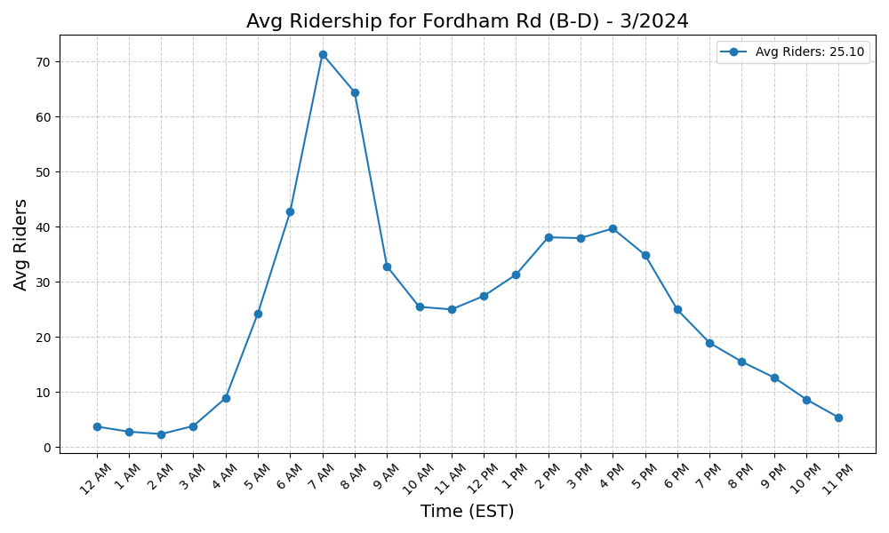
Fordham Rd (B-D) - 3/2024

Slide 21
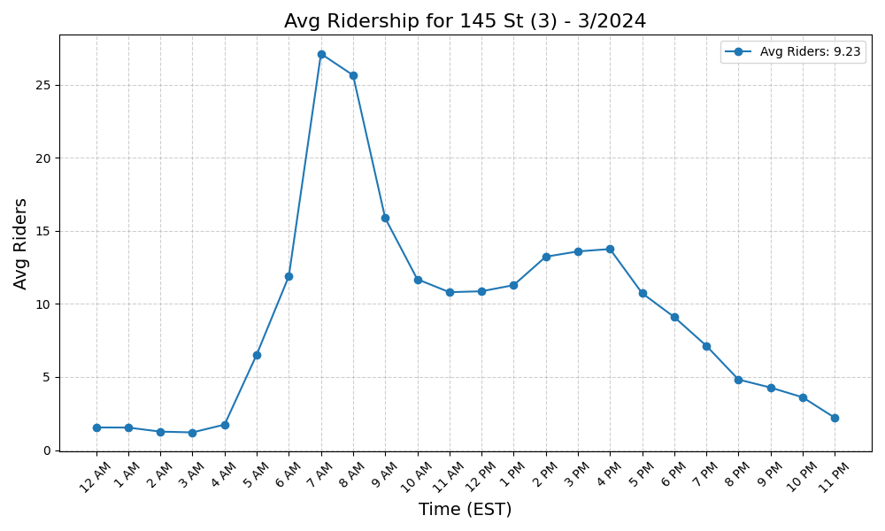
145 St (3) - 3/2024

Slide 22

88 St (A) - 3/2024

Slide 23
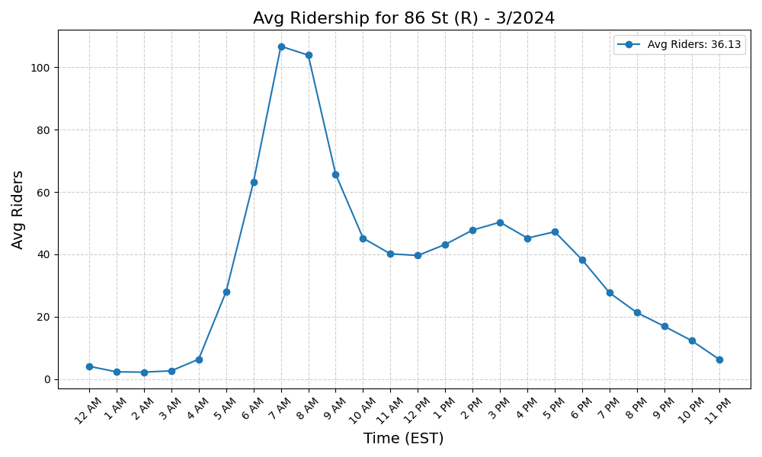
86 St (R) - 3/2024

Slide 24
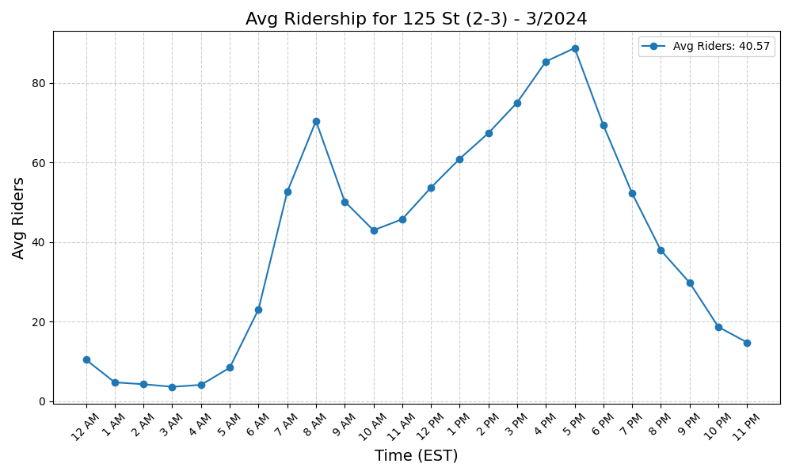
125 St (2-3) - 3/2024

Slide 25
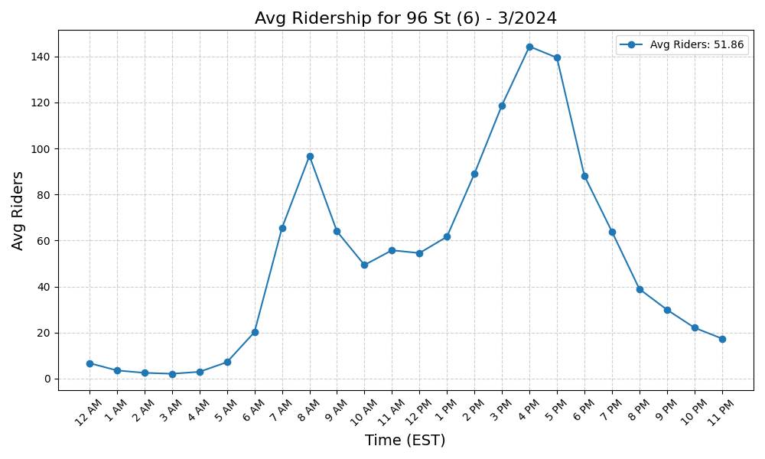
96 St (6) - 3/2024

Slide 26
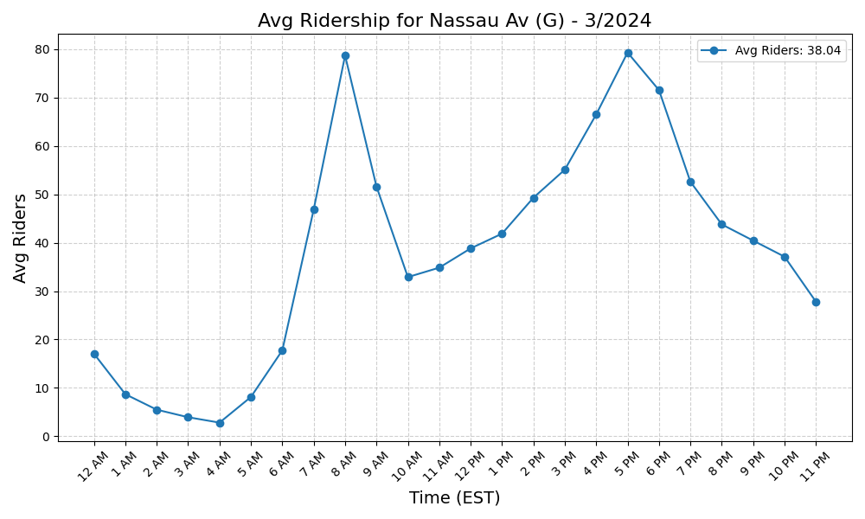
Nassau Av (G) - 3/2024

Slide 27

67 Av (M-R) - 3/2024

Slide 28
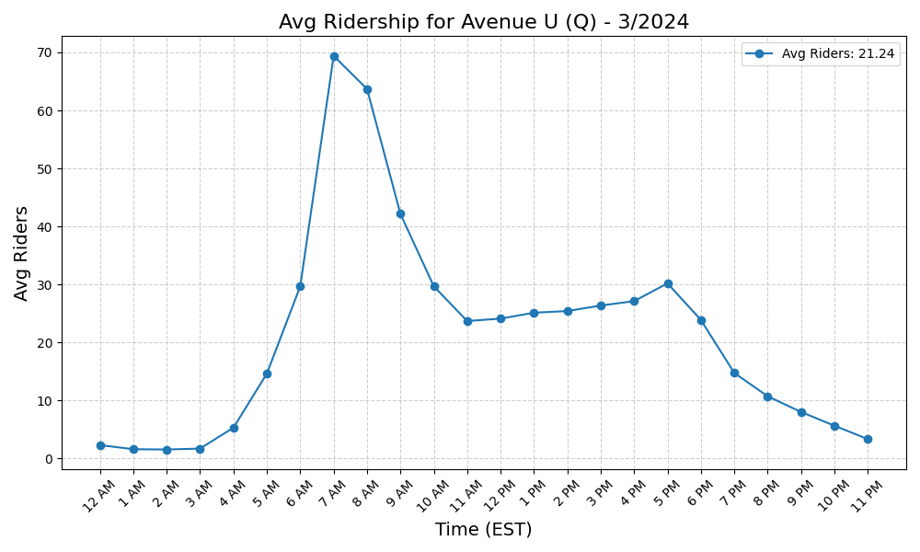
Avenue U (Q) - 3/2024

Slide 29
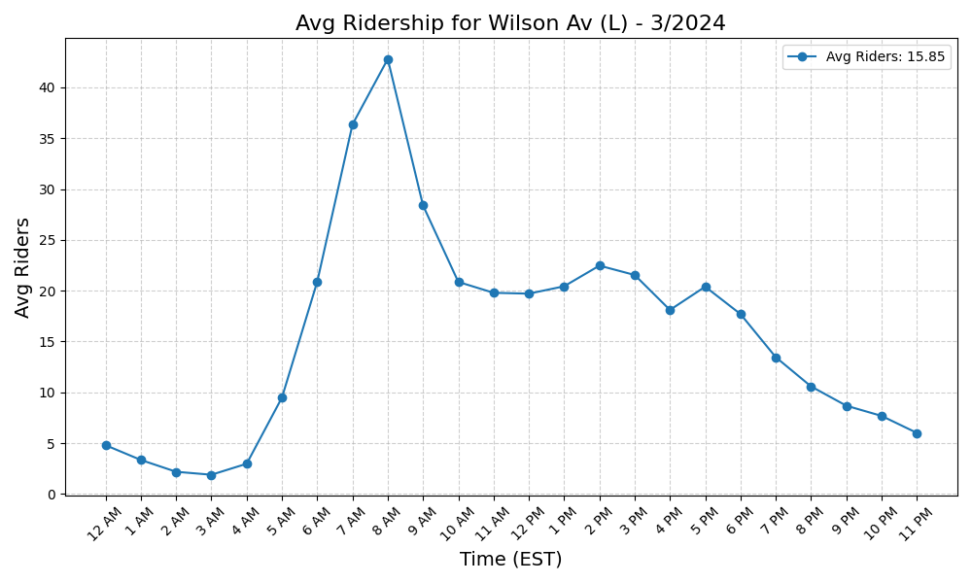
Wilson Av (L) - 3/2024

Slide 30

225 St (2-5) - 3/2024

Slide 31
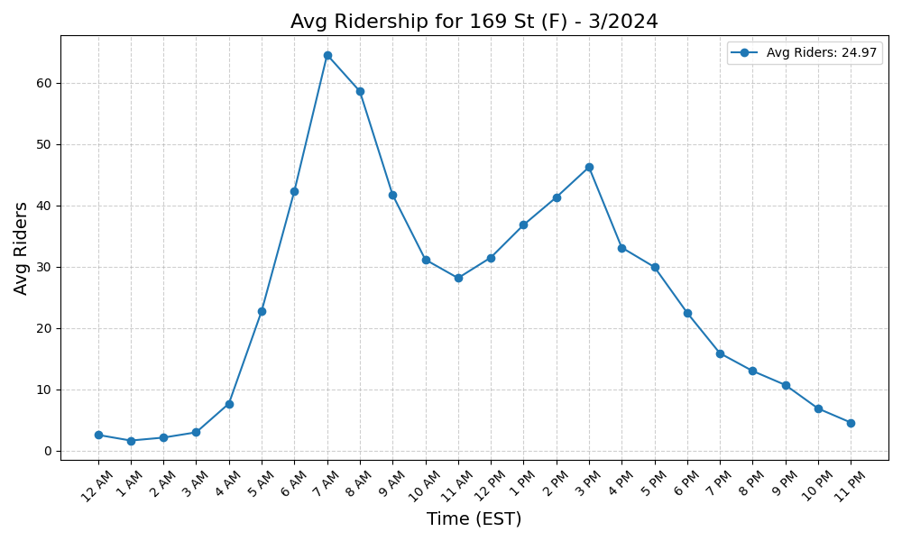
169 St (F) - 3/2024

Slide 32
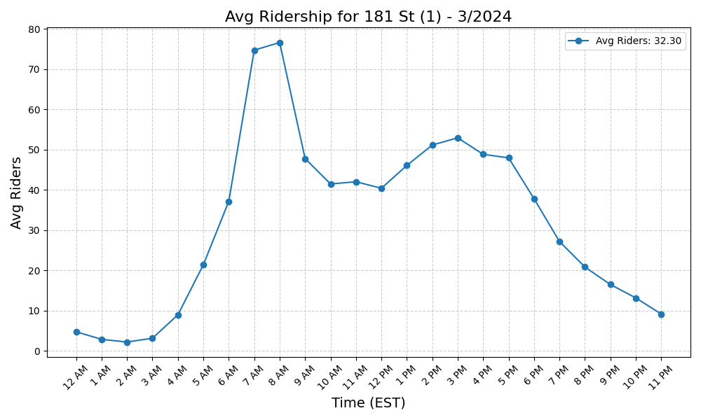
181 St (1) - 3/2024

Slide 33
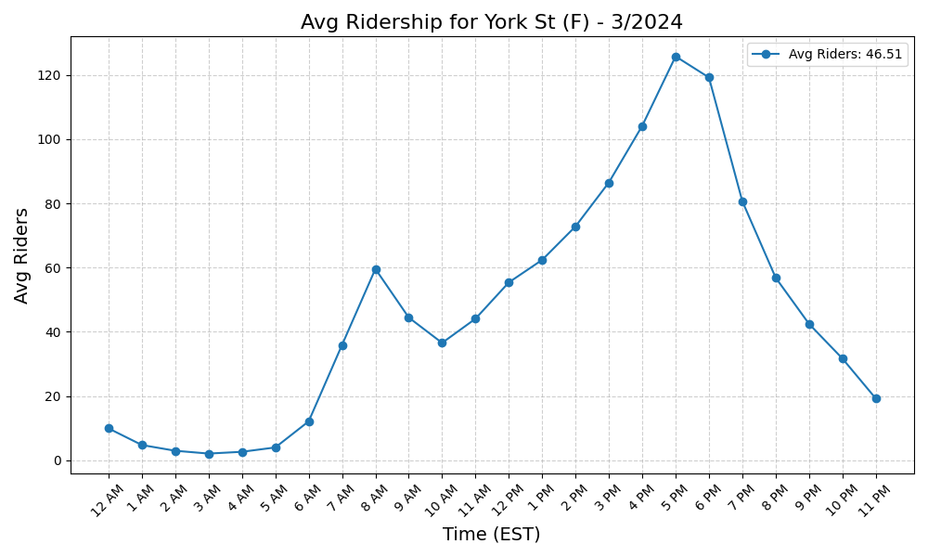
York St (F) - 3/2024

Slide 34
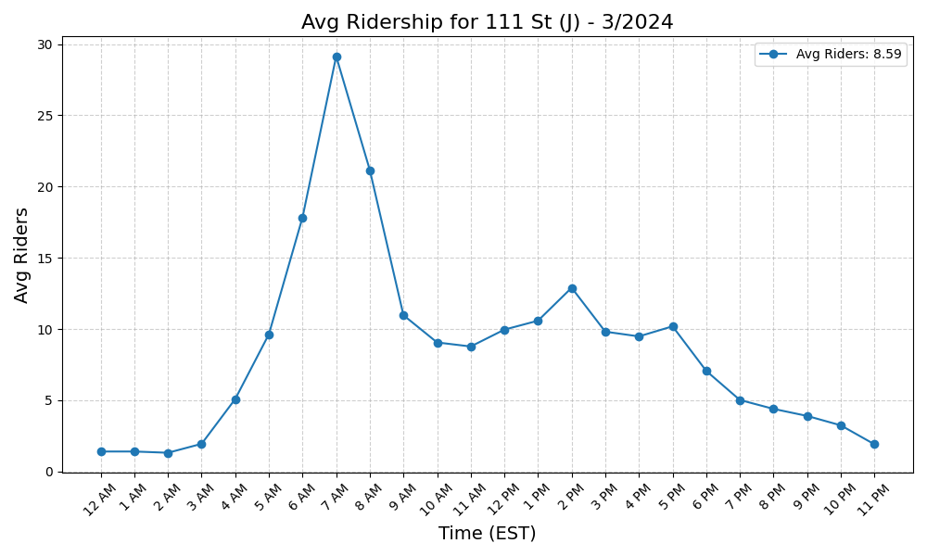
111 St (J) - 3/2024

Slide 35
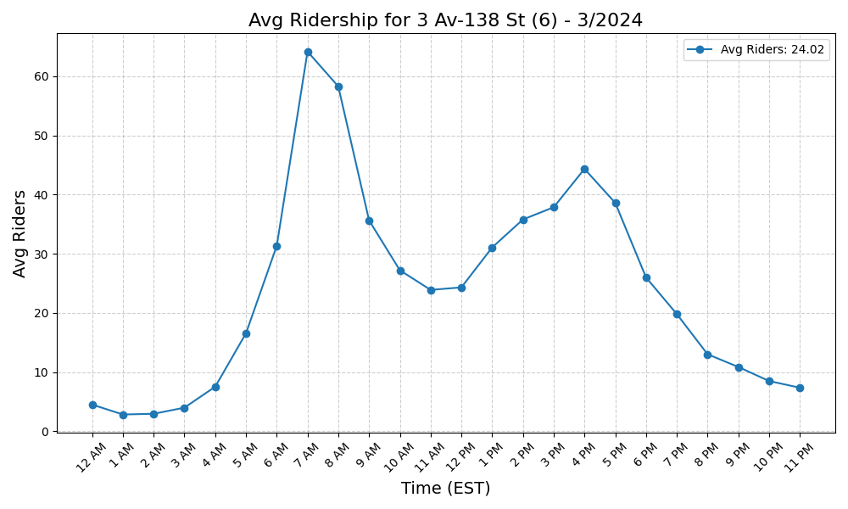
3 Av-138 St (6) - 3/2024

Slide 36

183 St (4) - 3/2024

Slide 37
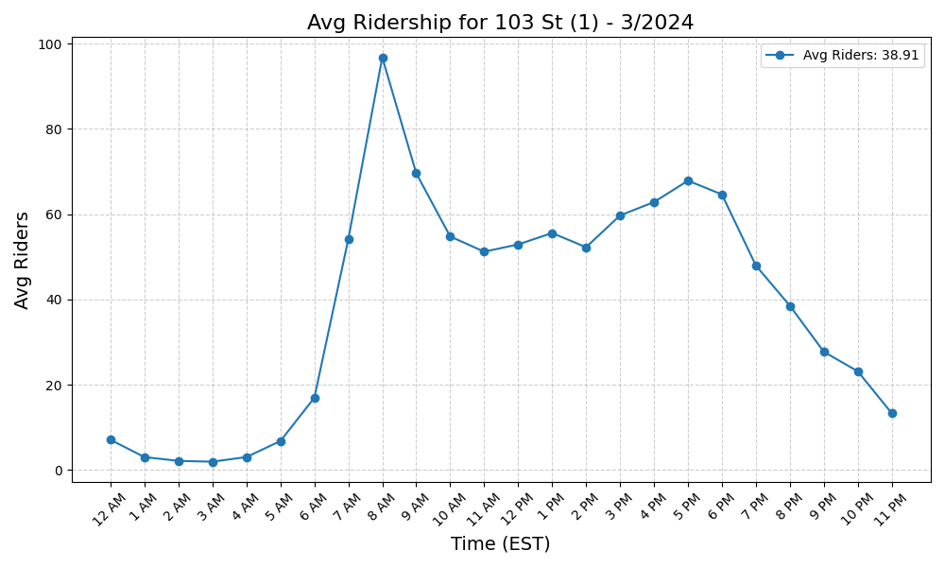
103 St (1) - 3/2024

Slide 38
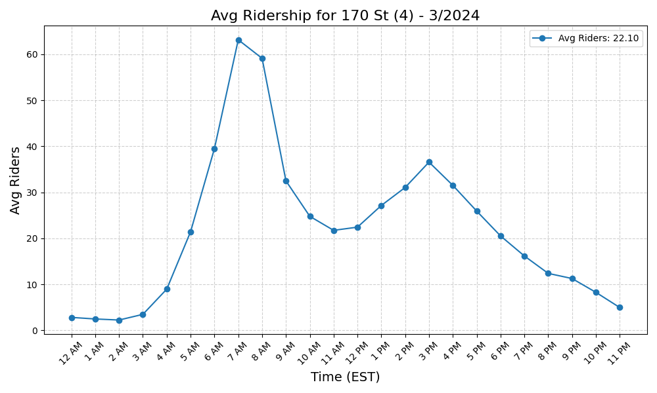
170 St (4) - 3/2024

Slide 39
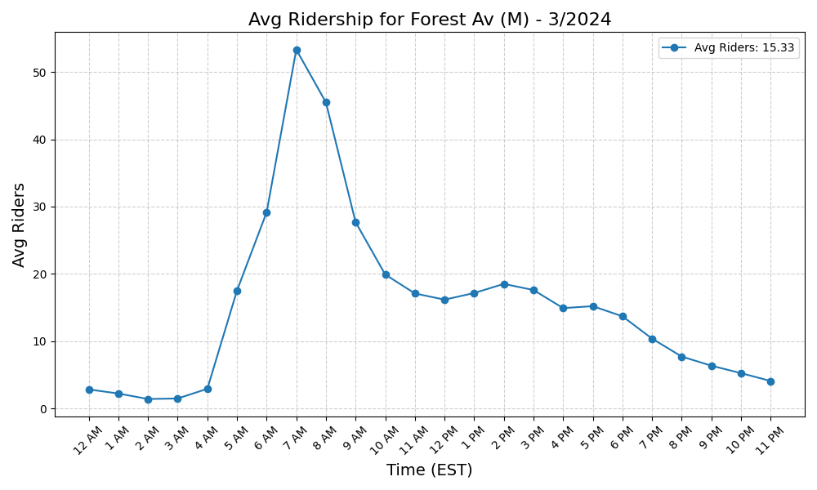
Forest Av (M) - 3/2024

Slide 40
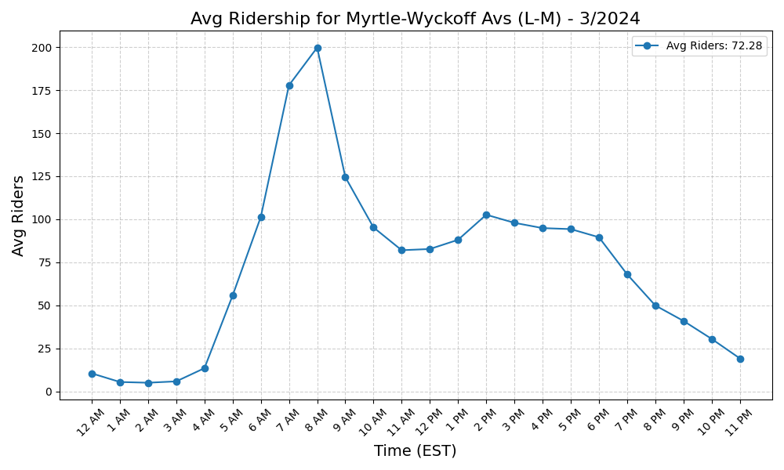
Myrtle-Wyckoff Avs (L-M) - 3/2024

Slide 41
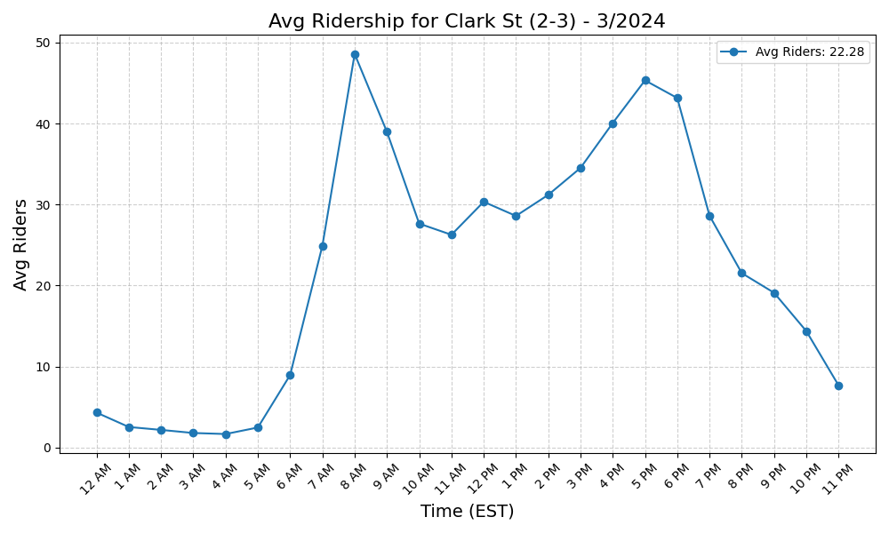
Clark St (2-3) - 3/2024

Slide 42
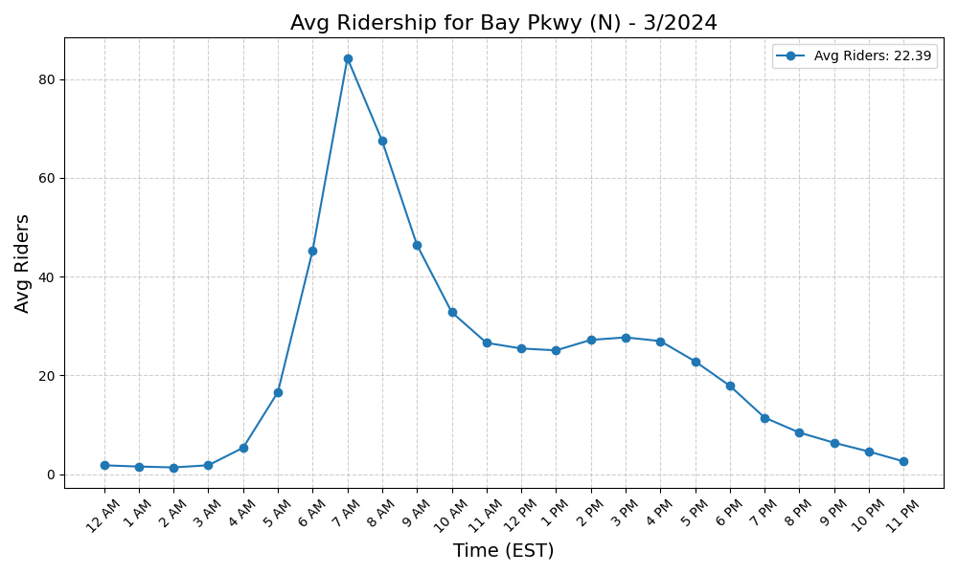
Bay Pkwy (N) - 3/2024

Slide 43
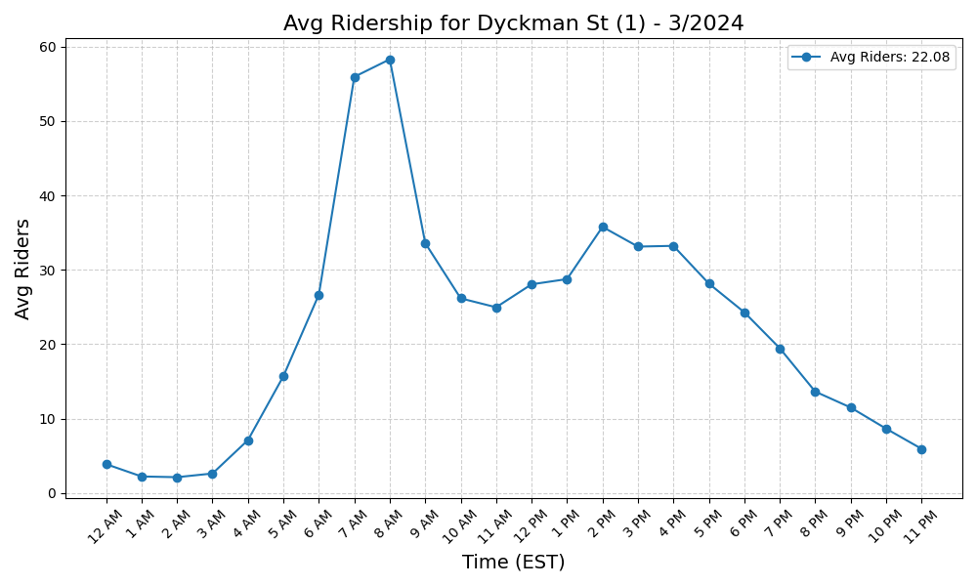
Dyckman St (1) - 3/2024

Slide 44
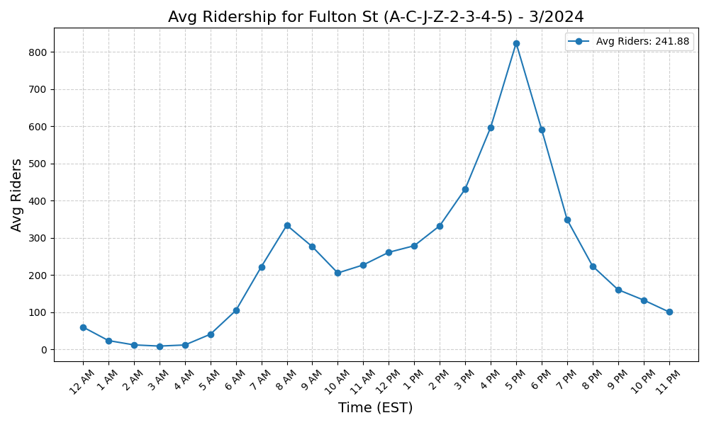
Fulton St (A-C-J-Z-2-3-4-5) - 3/2024

Slide 45
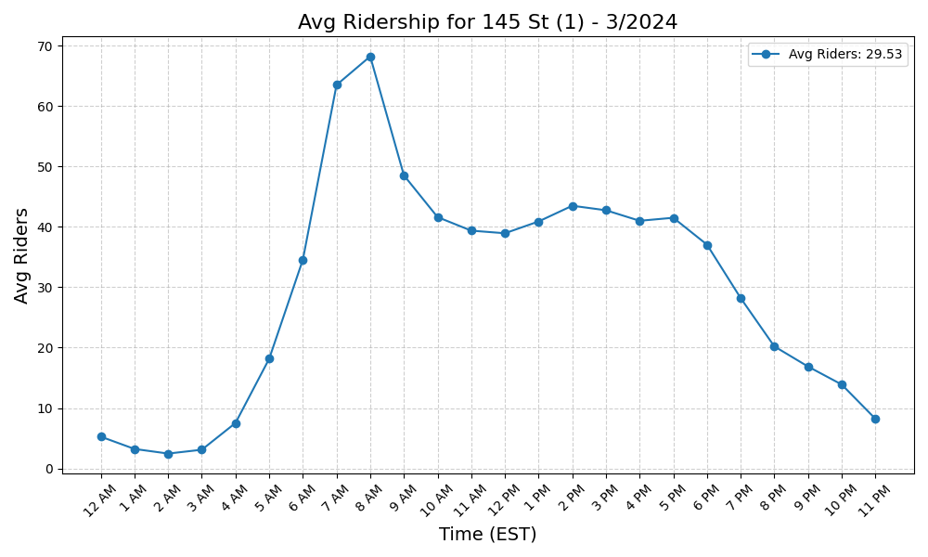
145 St (1) - 3/2024

Slide 46
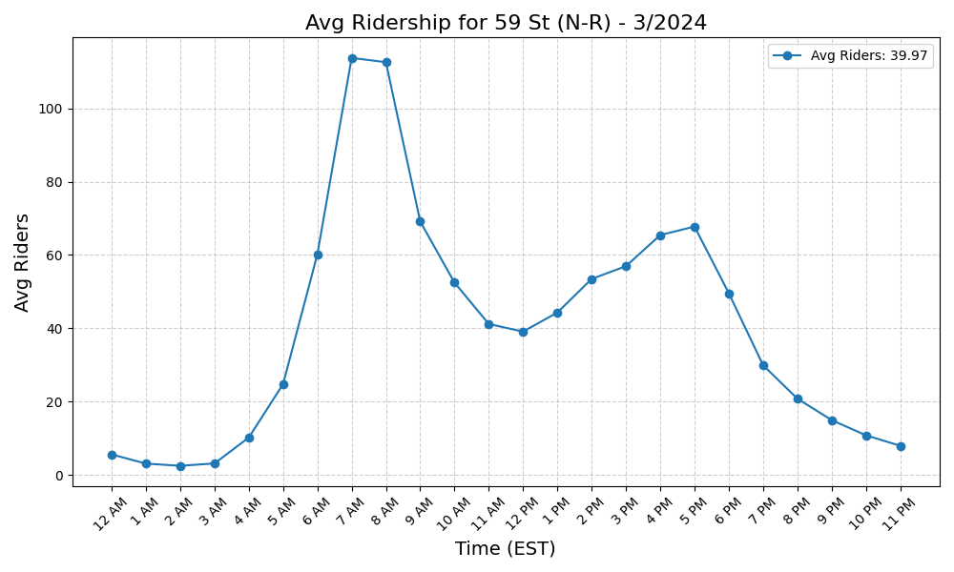
59 St (N-R) - 3/2024

Slide 47

E 180 St (2-5) - 3/2024

Slide 48
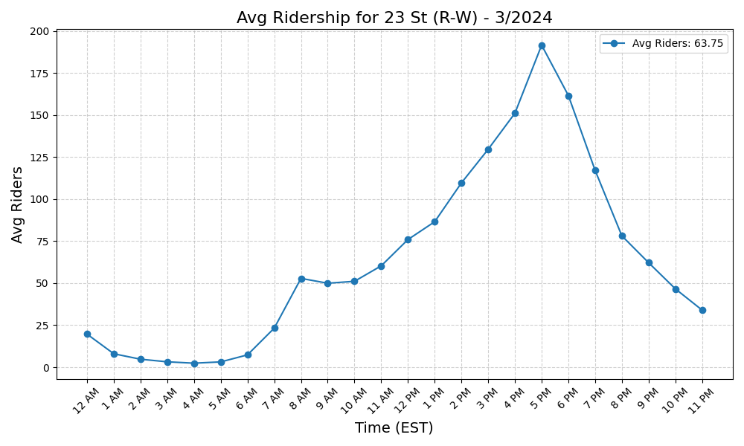
23 St (R-W) - 3/2024

Slide 49
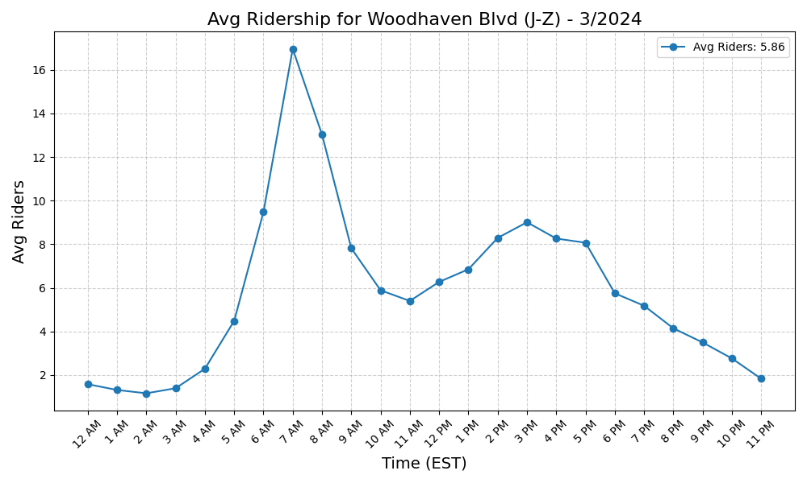
Woodhaven Blvd (J-Z) - 3/2024

Slide 50

Allerton Av (2-5) - 3/2024

Slide 51
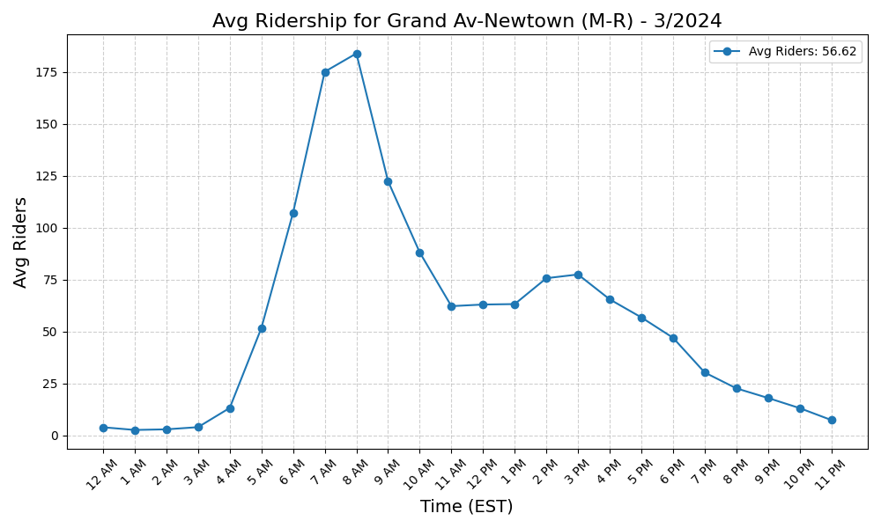
Grand Av-Newtown (M-R) - 3/2024

Slide 52
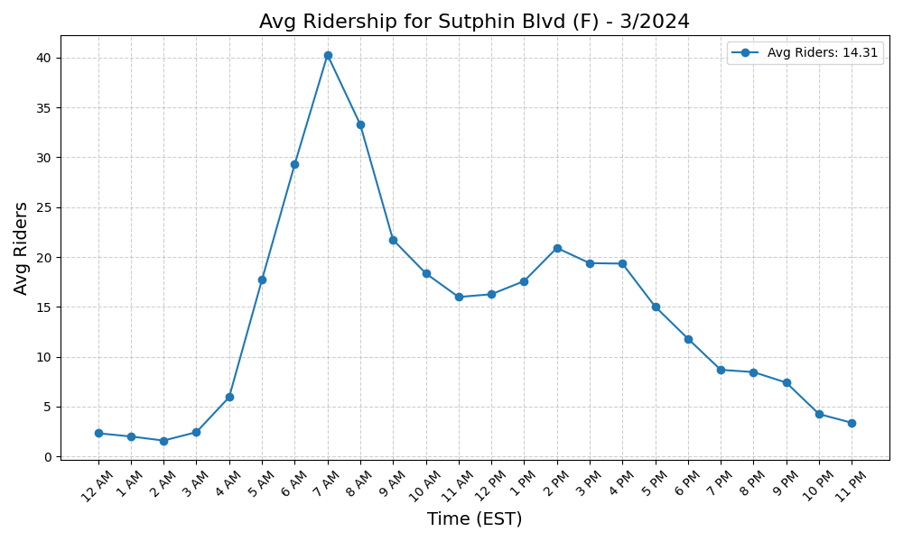
Sutphin Blvd (F) - 3/2024

Slide 53
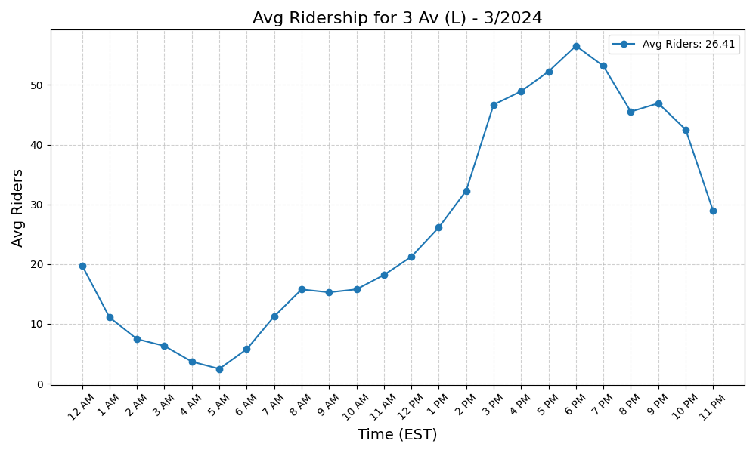
3 Av (L) - 3/2024

Slide 54
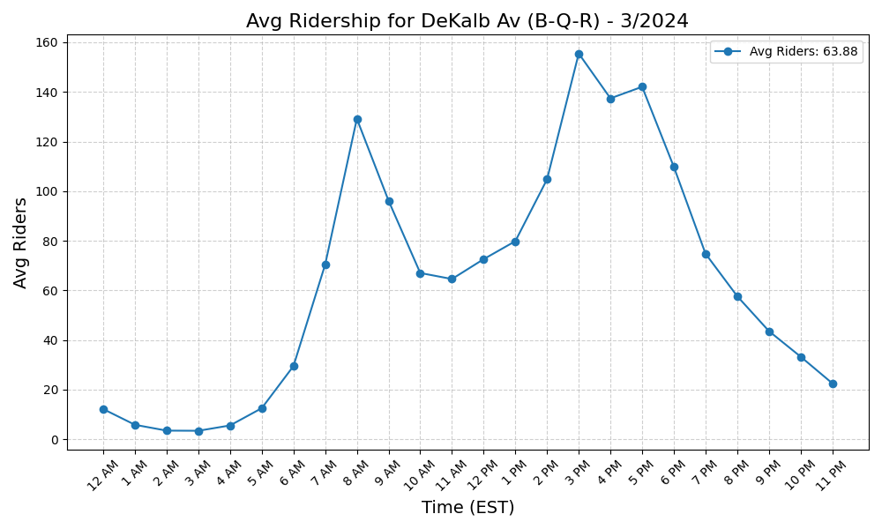
DeKalb Av (B-Q-R) - 3/2024

Slide 55
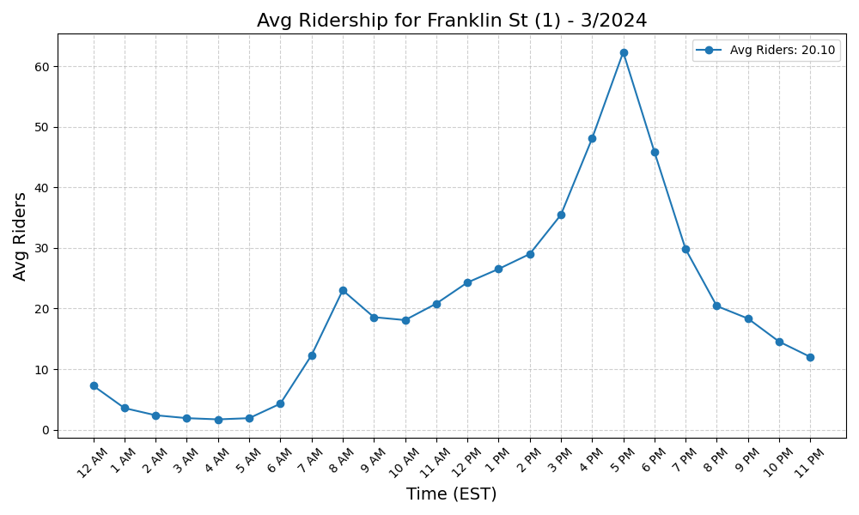
Franklin St (1) - 3/2024

Slide 56
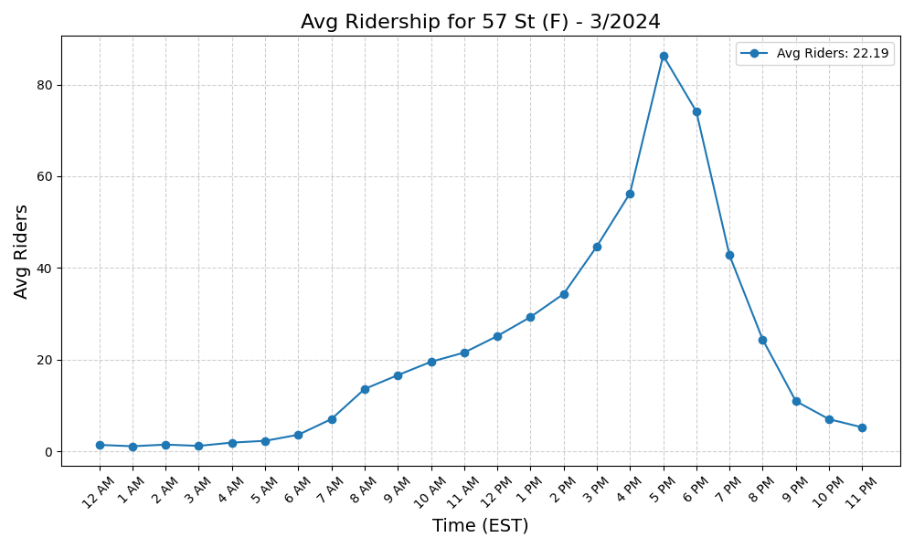
57 St (F) - 3/2024

Slide 57
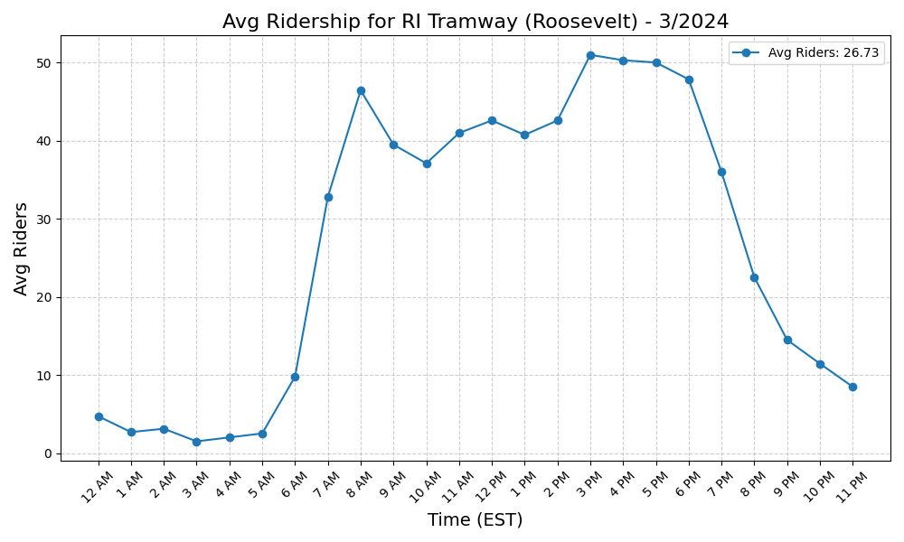
RI Tramway (Roosevelt) - 3/2024

Slide 58
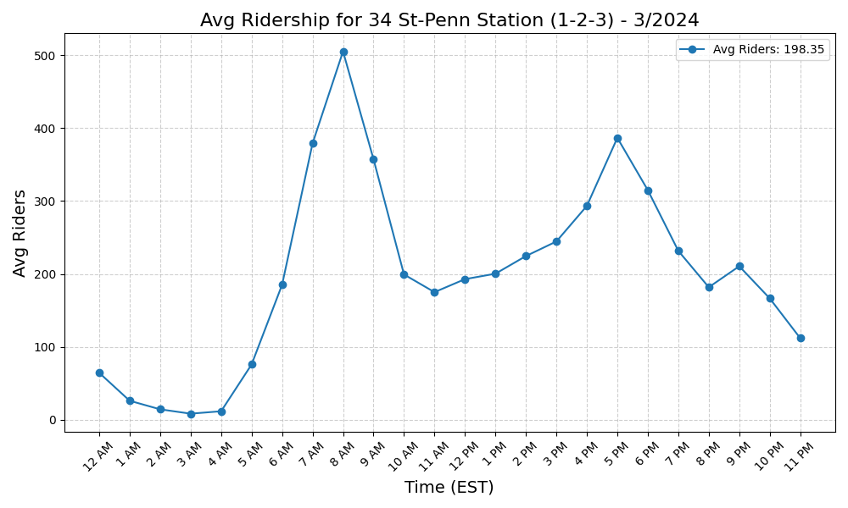
34 St-Penn Station (1-2-3) - 3/2024

Slide 59

77 St (6) - 3/2024

Slide 60

Jamaica-Van Wyck (E) - 3/2024

Slide 61

Park Pl (S) - 3/2024

Slide 62

66 St-Lincoln Center (1) - 3/2024

Slide 63

72 St (1-2-3) - 3/2024

Slide 64

Hoyt St (2-3) - 3/2024

Slide 65

86 St (1) - 3/2024

Slide 66

Kingston Av (3) - 3/2024

Slide 67

Woodlawn (4) - 3/2024

Slide 68

Saratoga Av (3) - 3/2024

Slide 69

East 105 St (L) - 3/2024

Slide 70

Church Av (B-Q) - 3/2024

Slide 71

63 Dr-Rego Park (M-R) - 3/2024

Slide 72

Beach 67 St (A) - 3/2024

Slide 73

36 Av (N-W) - 3/2024

Slide 74

E 149 St (6) - 3/2024

Slide 75

Mets-Willets Point (7) - 3/2024

Slide 76

3 Av-149 St (2-5) - 3/2024

Slide 77

74-Broadway (7)-Jackson Hts-Roo - 3/2024

Slide 78

Jay St-MetroTech (A-C-F-R) - 3/2024

Slide 79

Atlantic Av-Barclays Ctr (B-D-N - 3/2024

Slide 80

Euclid Av (A-C) - 3/2024

Slide 81

86 St (Q) - 3/2024

Slide 82

8 St-NYU (R-W) - 3/2024

Slide 83

Avenue J (Q) - 3/2024

Slide 84

Smith-9 Sts (F-G) - 3/2024

Slide 85

Kingston-Throop Avs (C) - 3/2024

Slide 86

86 St (4-5-6) - 3/2024

Slide 87

Van Siclen Av (J-Z) - 3/2024

Slide 88

Jamaica Center-Parsons-Archer ( - 3/2024

Slide 89

15 St-Prospect Park (F-G) - 3/2024

Slide 90

34 St-Penn Station (A-C-E) - 3/2024

Slide 91

Whitlock Av (6) - 3/2024

Slide 92

Utica Av (A-C) - 3/2024

Slide 93

Crown Hts-Utica Av (3-4) - 3/2024

Slide 94

Prospect Park (B-Q-S) - 3/2024

Slide 95

69 St (7) - 3/2024

Slide 96

Van Siclen Av (C) - 3/2024

Slide 97

175 St (A) - 3/2024

Slide 98

Inwood-207 St (A) - 3/2024

Slide 99

68 St-Hunter College (6) - 3/2024

Slide 100

18 Av (F) - 3/2024

Slide 101

Rector St (1) - 3/2024

Slide 102

Jefferson St (L) - 3/2024

Slide 103

Nostrand Av (3) - 3/2024

Slide 104

Mt Eden Av (4) - 3/2024

Slide 105

Clinton-Washington Avs (C) - 3/2024

Slide 106

40 St-Lowery St (7) - 3/2024

Slide 107

Nevins St (2-3-4-5) - 3/2024

Slide 108

Norwood-205 St (D) - 3/2024

Slide 109

St George (SIR) - 3/2024

Slide 110

Broadway (G) - 3/2024

Slide 111

Houston St (1) - 3/2024

Slide 112

Beach 98 St (A-S) - 3/2024

Slide 113

Steinway St (M-R) - 3/2024

Slide 114

Tremont Av (B-D) - 3/2024

Slide 115

Bronx Park East (2-5) - 3/2024

Slide 116

Wall St (2-3) - 3/2024

Slide 117

7 Av (F-G) - 3/2024

Slide 118

New Utrecht Av (N)-62 St (D) - 3/2024

Slide 119

Gun Hill Rd (2-5) - 3/2024

Slide 120

Morgan Av (L) - 3/2024

Slide 121

96 St (Q) - 3/2024

Slide 122

Fresh Pond Rd (M) - 3/2024

Slide 123

168 St (A-C-1) - 3/2024

Slide 124

7 Av (E-B-D) - 3/2024

Slide 125

116 St (C-B) - 3/2024

Slide 126

Seneca Av (M) - 3/2024

Slide 127

Sheepshead Bay (B-Q) - 3/2024

Slide 128

Avenue N (F) - 3/2024

Slide 129

135 St (2-3) - 3/2024

Slide 130

Clinton-Washington Avs (G) - 3/2024

Slide 131

Halsey St (J) - 3/2024

Slide 132

238 St (1) - 3/2024

Slide 133

14 St (A-C-E)-8 Av (L) - 3/2024

Slide 134

23 St (6) - 3/2024

Slide 135

Prospect Av (2-5) - 3/2024

Slide 136

28 St (6) - 3/2024

Slide 137

Fordham Rd (4) - 3/2024

Slide 138

Greenpoint Av (G) - 3/2024

Slide 139

Flushing-Main St (7) - 3/2024

Slide 140

Chambers St (1-2-3) - 3/2024

Slide 141

96 St (C-B) - 3/2024

Slide 142

61 St-Woodside (7) - 3/2024

Slide 143

Beach 44 St (A) - 3/2024

Slide 144

Halsey St (L) - 3/2024

Slide 145

Dyckman St (A) - 3/2024

Slide 146

Lexington Av-63 St (F-Q) - 3/2024

Slide 147

Kosciuszko St (J) - 3/2024

Slide 148

79 St (D) - 3/2024

Slide 149

Fulton St (G) - 3/2024

Slide 150

14 St-Union Sq (L-N-Q-R-W-4-5-6 - 3/2024

Slide 151

135 St (C-B) - 3/2024

Slide 152

9 Av (D) - 3/2024

Slide 153

Howard Beach-JFK Airport (A) - 3/2024

Slide 154

Grand Central-42 St (S-4-5-6-7) - 3/2024

Slide 155

Bay Pkwy (F) - 3/2024

Slide 156

West Farms Sq-E Tremont Av (2-5 - 3/2024

Slide 157

39 Av-Dutch Kills (N-W) - 3/2024

Slide 158

Elder Av (6) - 3/2024

Slide 159

77 St (R) - 3/2024

Slide 160

Freeman St (2-5) - 3/2024

Slide 161

Beach 90 St (A-S) - 3/2024

Slide 162

103 St-Corona Plaza (7) - 3/2024

Slide 163

Zerega Av (6) - 3/2024

Slide 164

149 St-Grand Concourse (2-4-5) - 3/2024

Slide 165

Bedford Park Blvd (B-D) - 3/2024

Slide 166

Morrison Av-Soundview (6) - 3/2024

Slide 167

Shepherd Av (C) - 3/2024

Slide 168

Northern Blvd (M-R) - 3/2024

Slide 169

Aqueduct Racetrack (A) - 3/2024

Slide 170

Ditmas Av (F) - 3/2024

Slide 171

5 Av-59 St (N-R-W) - 3/2024

Slide 172

WTC Cortlandt (1) - 3/2024

Slide 173

Beverley Rd (Q) - 3/2024

Slide 174

Broadway-Lafayette St (B-D-F-M) - 3/2024

Slide 175

Myrtle Av (M-J-Z) - 3/2024

Slide 176

111 St (7) - 3/2024

Slide 177

Rockaway Blvd (A) - 3/2024

Slide 178

Franklin Av (2-3-4-5)-Botanic G - 3/2024

Slide 179

103 St (6) - 3/2024

Slide 180

Canal St (A-C-E) - 3/2024

Slide 181

Avenue X (F) - 3/2024

Slide 182

Franklin Av (C-S) - 3/2024

Slide 183

23 St (F-M) - 3/2024

Slide 184

Wall St (4-5) - 3/2024

Slide 185

Rockaway Av (C) - 3/2024

Slide 186

Brighton Beach (B-Q) - 3/2024

Slide 187

Beach 36 St (A) - 3/2024

Slide 188

Astoria Blvd (N-W) - 3/2024

Slide 189

Cortelyou Rd (Q) - 3/2024

Slide 190

Christopher St-Sheridan Sq (1) - 3/2024

Slide 191

Van Siclen Av (3) - 3/2024

Slide 192

181 St (A) - 3/2024

Slide 193

155 St (C) - 3/2024

Slide 194

Bowling Green (4-5) - 3/2024

Slide 195

Bay Pkwy (D) - 3/2024

Slide 196

Canarsie-Rockaway Pkwy (L) - 3/2024

Slide 197

163 St-Amsterdam Av (C) - 3/2024

Slide 198

Sutphin Blvd-Archer Av-JFK Airp - 3/2024

Slide 199

Pelham Pkwy (2-5) - 3/2024

Slide 200

Ozone Park-Lefferts Blvd (A) - 3/2024

Slide 201

50 St (1) - 3/2024

Slide 202

25 Av (D) - 3/2024

Slide 203

155 St (B-D) - 3/2024

Slide 204

Marcy Av (M-J-Z) - 3/2024

Slide 205

Westchester Sq-E Tremont Av (6) - 3/2024

Slide 206

Church Av (F-G) - 3/2024

Slide 207

Beach 25 St (A) - 3/2024

Slide 208

Eastern Pkwy-Brooklyn Museum (2 - 3/2024

Slide 209

Bay 50 St (D) - 3/2024

Slide 210

59 St-Columbus Circle (A-B-C-D- - 3/2024

Slide 211

137 St-City College (1) - 3/2024

Slide 212

20 Av (D) - 3/2024

Slide 213

Graham Av (L) - 3/2024

Slide 214

96 St (1-2-3) - 3/2024

Slide 215

Neptune Av (F) - 3/2024

Slide 216

Jamaica-179 St (F) - 3/2024

Slide 217

Bay Ridge Av (R) - 3/2024

Slide 218

Kings Hwy (B-Q) - 3/2024

Slide 219

Livonia Av (L) - 3/2024

Slide 220

2 Av (F) - 3/2024

Slide 221

Fort Hamilton Pkwy (F-G) - 3/2024

Slide 222

219 St (2-5) - 3/2024

Slide 223

Fort Hamilton Pkwy (D) - 3/2024

Slide 224

Cleveland St (J) - 3/2024

Slide 225

Court Sq (E-G-M-7) - 3/2024

Slide 226

Grand Army Plaza (2-3) - 3/2024

Slide 227

Avenue U (F) - 3/2024

Slide 228

Baychester Av (5) - 3/2024

Slide 229

Chambers St (A-C)-WTC (E)-Park - 3/2024

Slide 230

33 St (6) - 3/2024

Slide 231

Kings Hwy (F) - 3/2024

Slide 232

Queensboro Plaza (7-N-W) - 3/2024

Slide 233

Sutter Av-Rutland Rd (3) - 3/2024

Slide 234

86 St (C-B) - 3/2024

Slide 235

President St-Medgar Evers Colle - 3/2024

Slide 236

53 St (R) - 3/2024

Slide 237

Hunters Point Av (7) - 3/2024

Slide 238

191 St (1) - 3/2024

Slide 239

Crescent St (J-Z) - 3/2024

Slide 240

Pennsylvania Av (3) - 3/2024

Slide 241

79 St (1) - 3/2024

Slide 242

Nereid Av (2-5) - 3/2024

Slide 243

Cypress Hills (J) - 3/2024

Slide 244

85 St-Forest Pkwy (J) - 3/2024

Slide 245

190 St (A) - 3/2024

Slide 246

23 St (C-E) - 3/2024

Slide 247

Bergen St (2-3) - 3/2024

Slide 248

161 St-Yankee Stadium (B-D-4) - 3/2024

Slide 249

36 St (M-R) - 3/2024

Slide 250

21 St-Queensbridge (F) - 3/2024

Slide 251

34 St-Hudson Yards (7) - 3/2024

Slide 252

Hewes St (M-J) - 3/2024

Slide 253

110 St (6) - 3/2024

Slide 254

Burke Av (2-5) - 3/2024

Slide 255

47-50 Sts-Rockefeller Ctr (B-D- - 3/2024

Slide 256

Flushing Av (M-J) - 3/2024

Slide 257

Eastchester-Dyre Av (5) - 3/2024

Slide 258

Sutter Av (L) - 3/2024

Slide 259

Cypress Av (6) - 3/2024

Slide 260

Middle Village-Metropolitan Av - 3/2024

Slide 261

Delancey St (F)-Essex St (J-M-Z - 3/2024

Slide 262

71 St (D) - 3/2024

Slide 263

Kingsbridge Rd (B-D) - 3/2024

Slide 264

Jackson Av (2-5) - 3/2024

Slide 265

E 143 St-St Mary-s St (6) - 3/2024

Slide 266

5 Av-53 St (E-M) - 3/2024

Slide 267

Bergen St (F-G) - 3/2024

Slide 268

Far Rockaway-Mott Av (A) - 3/2024

Slide 269

25 St (R) - 3/2024

Slide 270

Newkirk Av-Little Haiti (2-5) - 3/2024

Slide 271

Newkirk Plaza (B-Q) - 3/2024

Slide 272

High St (A-C) - 3/2024

Slide 273

Prospect Av (R) - 3/2024

Slide 274

W 8 St-NY Aquarium (F-Q) - 3/2024

Slide 275

South Ferry (1)-Whitehall St (R - 3/2024

Slide 276

170 St (B-D) - 3/2024

Slide 277

116 St (2-3) - 3/2024

Slide 278

Roosevelt Island (F) - 3/2024

Slide 279

Lexington Av-53 St (E-M)-51 St - 3/2024

Slide 280

Pelham Pkwy (5) - 3/2024

Slide 281

34 St-Herald Sq (B-D-F-M-N-Q-R- - 3/2024

Slide 282

4 Av (F-G)-9 St (R) - 3/2024

Slide 283

Ralph Av (C) - 3/2024

Slide 284

57 St-7 Av (N-Q-R-W) - 3/2024

Slide 285

Avenue H (Q) - 3/2024

Slide 286

Broadway Junction (A-C-J-L-Z) - 3/2024

Slide 287

174-175 Sts (B-D) - 3/2024

Slide 288

Brooklyn Bridge-City Hall (4-5- - 3/2024

Slide 289

28 St (1) - 3/2024

Slide 290

Broad St (J-Z) - 3/2024

Slide 291

Marble Hill-225 St (1) - 3/2024

Slide 292

33 St-Rawson St (7) - 3/2024

Slide 293

New Lots Av (L) - 3/2024

Slide 294

18 St (1) - 3/2024

Slide 295

Intervale Av (2-5) - 3/2024

Slide 296

DeKalb Av (L) - 3/2024

Slide 297

Queens Plaza (E-M-R) - 3/2024

Slide 298

Ocean Pkwy (Q) - 3/2024

Slide 299

125 St (4-5-6) - 3/2024

Slide 300

45 St (R) - 3/2024

Slide 301

New Lots Av (3) - 3/2024

Slide 302

46 St-Bliss St (7) - 3/2024

Slide 303

Parkchester (6) - 3/2024

Slide 304

Woodhaven Blvd (M-R) - 3/2024

Slide 305

Myrtle-Willoughby Avs (G) - 3/2024

Slide 306

Beverly Rd (2-5) - 3/2024

Slide 307

Avenue M (Q) - 3/2024

Slide 308

Winthrop St (2-5) - 3/2024

Slide 309

Spring St (6) - 3/2024

Slide 310

Flatbush Av-Brooklyn College (2 - 3/2024

Slide 311

Montrose Av (L) - 3/2024

Slide 312

Hunts Point Av (6) - 3/2024

Slide 313

Lorimer St (M-J) - 3/2024

Slide 314

Brook Av (6) - 3/2024

Slide 315

Bedford Park Blvd-Lehman Colleg - 3/2024

Slide 316

28 St (R-W) - 3/2024

Slide 317

Carroll St (F-G) - 3/2024

Slide 318

Prince St (R-W) - 3/2024

Slide 319

182-183 Sts (B-D) - 3/2024

Slide 320

Astor Pl (6) - 3/2024

Slide 321

103 St (C-B) - 3/2024

Slide 322

Harlem-148 St (3) - 3/2024

Slide 323

Norwood Av (J-Z) - 3/2024

Slide 324

138 St-Grand Concourse (4-5) - 3/2024

Slide 325

East Broadway (F) - 3/2024

Slide 326

Simpson St (2-5) - 3/2024

Slide 327

Rockaway Park-Beach 116 St (A-S - 3/2024

Slide 328

Canal St (1) - 3/2024

Slide 329

Cathedral Pkwy (110 St) (1) - 3/2024

Slide 330

72 St (Q) - 3/2024

Slide 331

14 St (F-M-1-2-3)-6 Av (L) - 3/2024

Slide 332

W 4 St-Wash Sq (A-C-E-B-D-F-M) - 3/2024

Slide 333

Grand St (L) - 3/2024

Slide 334

125 St (A-C-B-D) - 3/2024

Slide 335

116 St-Columbia University (1) - 3/2024

Slide 336

Middletown Rd (6) - 3/2024

Slide 337

Kingsbridge Rd (4) - 3/2024

Slide 338

23 St (1) - 3/2024

Slide 339

55 St (D) - 3/2024

Slide 340

Gates Av (J-Z) - 3/2024

Slide 341

121 St (J-Z) - 3/2024

Slide 342

75 Av (E-F) - 3/2024

Slide 343

207 St (1) - 3/2024

Slide 344

104 St (J-Z) - 3/2024

Slide 345

Pelham Bay Park (6) - 3/2024

Slide 346

Kings Hwy (N) - 3/2024

Slide 347

Astoria-Ditmars Blvd (N-W) - 3/2024

Slide 348

Gun Hill Rd (5) - 3/2024

Slide 349

Lafayette Av (C) - 3/2024

Slide 350

72 St (C-B) - 3/2024

Slide 351

Broadway (N-W) - 3/2024

Slide 352

Avenue P (F) - 3/2024

Slide 353

Mosholu Pkwy (4) - 3/2024

Slide 354

Court St (R)-Borough Hall (2-3- - 3/2024

Slide 355

46 St (M-R) - 3/2024

Slide 356

Canal St (J-N-Q-R-W-Z-6) - 3/2024

Slide 357

174 St (2-5) - 3/2024

Slide 358

Parsons Blvd (F) - 3/2024

Slide 359

Alabama Av (J) - 3/2024

Slide 360

49 St (N-R-W) - 3/2024

Slide 361

Briarwood (E-F) - 3/2024

Slide 362

Bedford Av (L) - 3/2024

Slide 363

Sterling St (2-5) - 3/2024

Slide 364

Flushing Av (G) - 3/2024

Slide 365

111 St (A) - 3/2024

Slide 366

82 St-Jackson Hts (7) - 3/2024

Slide 367

Hoyt-Schermerhorn Sts (A-C-G) - 3/2024

Slide 368

Bedford-Nostrand Avs (G) - 3/2024

Slide 369

Coney Island-Stillwell Av (D-F- - 3/2024

Slide 370

Lexington Av (N-R-W)-59 St (4-5 - 3/2024

Slide 371

Rockaway Av (3) - 3/2024

Slide 372

Central Av (M) - 3/2024

Slide 373

52 St (7) - 3/2024

Slide 374

7 Av (B-Q) - 3/2024

Slide 375

Forest Hills-71 Av (E-F-M-R) - 3/2024

Slide 376

116 St (6) - 3/2024

Slide 377

231 St (1) - 3/2024

Slide 378

Bay Ridge-95 St (R) - 3/2024

Slide 379

Nostrand Av (A-C) - 3/2024

Slide 380

Atlantic Av (L) - 3/2024

Slide 381

Bowery (J-Z) - 3/2024

Slide 382

18 Av (N) - 3/2024

Slide 383

Broad Channel (A-S) - 3/2024

Slide 384

50 St (D) - 3/2024

Slide 385

Spring St (C-E) - 3/2024

Slide 386

86 St (N) - 3/2024

Slide 387

Aqueduct-N Conduit Av (A) - 3/2024

Slide 388

1 Av (L) - 3/2024

Slide 389

Cathedral Pkwy (110 St) (C-B) - 3/2024

Slide 390

Burnside Av (4) - 3/2024

Slide 391

Junction Blvd (7) - 3/2024

Slide 392

30 Av (N-W) - 3/2024

Slide 393

Elmhurst Av (M-R) - 3/2024

Slide 394

Lorimer St (L)-Metropolitan Av - 3/2024

Slide 395

167 St (4) - 3/2024

Slide 396

50 St (C-E) - 3/2024

Slide 397

90 St-Elmhurst Av (7) - 3/2024

Slide 398

Kew Gardens-Union Tpke (E-F) - 3/2024

Slide 399

21 St (G) - 3/2024

Slide 400

Church Av (2-5) - 3/2024

Slide 401

145 St (A-C-B-D) - 3/2024

Slide 402

Grand St (B-D) - 3/2024

Slide 403

Bushwick Av-Aberdeen St (L) - 3/2024

Slide 404

Central Park North (110 St) (2- - 3/2024

Slide 405

City Hall (R-W) - 3/2024

Slide 406

Parkside Av (Q) - 3/2024

Slide 407

Van Cortlandt Park-242 St (1) - 3/2024

Slide 408

Beach 105 St (A-S) - 3/2024

Slide 409

RI Tramway (Manhattan) - 3/2024

Slide 410

18 Av (D) - 3/2024

Slide 411

Liberty Av (C) - 3/2024

Slide 412

Classon Av (G) - 3/2024

Slide 413

75 St-Elderts Ln (J-Z) - 3/2024

Slide 414

215 St (1) - 3/2024

Slide 415

Buhre Av (6) - 3/2024

Slide 416

Knickerbocker Av (M) - 3/2024

Slide 417

Chauncey St (J-Z) - 3/2024

Slide 418

81 St-Museum of Natural History - 3/2024

Slide 419

Rector St (R-W) - 3/2024

Slide 420

Vernon Blvd-Jackson Av (7) - 3/2024

Slide 421

Wakefield-241 St (2) - 3/2024

Slide 422

Bryant Pk (B-D-F-M)-5 Av (7) - 3/2024

Slide 423

125 St (1) - 3/2024

Slide 424

Tompkinsville (SIR) - 3/2024

Slide 425

Junius St (3) - 3/2024

Slide 426

Fort Hamilton Pkwy (N) - 3/2024

Slide 427

St Lawrence Av (6) - 3/2024

Slide 428

Times Sq-42 St (N-Q-R-W-S-1-2-3 - 3/2024

